Slide 1
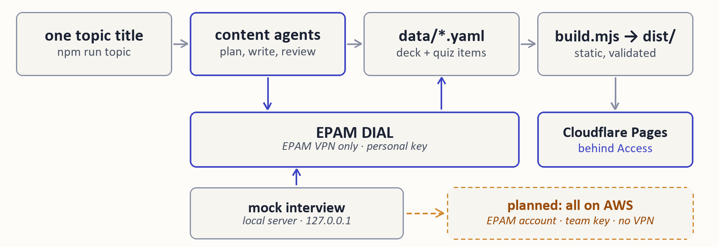
AI UPSKILL · SEPT 2026
3-WEEK INITIATIVE
LEARNING SITE, QUIZ AND MOCK INTERVIEW
TEAM
INTRODUCTION
OTHERS
Łukasz Kwaśniewski
Student
A static-site generator plus three agent features: one topic title becomes a structured Q&A deck, a quiz on every card, and a mock interview that grades spoken-style answers against those cards.
IMPACT
Live behind Cloudflare Access: 44 interview questions, each with a generated quiz item. The mock interview grades answers against the cards and names what was missed. A new topic is one command, cents per deck.
SOLUTION
TECH STACK
LEARNINGS
Node.js
Cloudflare
GitHub
DIAL is reachable only through the EPAM VPN, and whitelisting covers EPAM-managed cloud only, so the mock interview cannot be served from the public site. The personal key also rules out team use.
Claude Code
js-yaml
cheerio
EPAM DIAL
NEXT STEPS
Host the whole thing on AWS in an EPAM-managed account: whitelisted outbound IP, a non-personal key, and the interview served from the site instead of a laptop. Then a daily spend cap per person.
BUSINESS CHALLENGES
Node.js build renders each deck's YAML through a template lifted from the prototype's own CSS/JS, zero framework. Three agent slices run on EPAM DIAL: quiz items generated ahead of time and committed as a diff, a mock interview served by a local server, and a pipeline that plans, writes and reviews a whole deck from one title, stopping twice for human review. Each agent uses the cheapest model that passed a spot check.
Study content trapped in one-off files
New topics mean repetitive manual work
Reading is not practice: no self-check
Generated answers need a review step
ADDITIONAL NOTES
Specs in-repo: site-generator, agents, topic-pipeline. 47 tests. Repo: github.com/Lukasz-dataeng/ai-upskill-learning-site (site needs an allowed email).
.NET AI UPSKILL INITIATIVE · SEPTEMBER 2026
CONFIDENTIAL

Slide 2


AI UPSKILL · TOPIC PIPELINE
From one topic title to a live study deck
01 · INPUT
02 · PLANNER
STOP 1 · HUMAN
03 · WRITE + CHECK
Topic
Plan
Review plan
Answer
One title, typed in a terminal.
Sections and questions in 3 depth tiers.
You read and edit the plan, then say yes.
Written, then checked by a second model.
gpt-5.6-luna → gemini-3.1-flash-lite
gemini-2.5-flash-lite
npm run topic
Continue? [y/N]
04 · QUIZ AGENTS
05 · BUILD
STOP 2 · HUMAN
06 · PUBLISH
Quiz
Preview
Approve
Live
One multiple-choice item per card.
Site built, mock interview on the new deck.
You check content and cost, then say yes.
Committed and deployed, behind a login.
gpt-5.6-luna
npm run interview
Publish? [y/N]
Cloudflare Pages
Test run, 8 questions: about 2 minutes, $0.02 on EPAM DIAL · each agent uses the cheapest model that passed a spot check
Notes:
Read it left to right, top row then bottom row. I type one title. A cheap Planner model proposes sections and questions, and the pipeline stops: I read the plan and can edit it before anything else is spent. Then each answer is written by one model and checked by a different one, with one rewrite if rejected. The existing quiz agents add a multiple-choice question per card, the site is built, and I can run the mock interview on the new deck locally. Second stop: I read the content and the cost report before approving. Only then is it committed and deployed. Why two stops: in the test run on Python Decorators the Reviewer passed two terminology slips that I caught by reading at stop 2. Models were chosen per agent, cheapest first, by a spot check recorded in the spec.

Slide 3
AI UPSKILL · ALTERNATIVE PATH
The same pipeline, driven from a conversation
YOU, IN CLAUDE CODE
CLAUDE · PUBLISH-CONTENT SKILL
STOP 1
“Make a deck on Object Oriented Programming in Python.”
Runs the pipeline, then summarises the plan for you.
Plan shown
You change it or say go on.
npm run topic -- "<title>"
YOU
CLAUDE
STOP 2
“Swap question 2.2, then go on.”
Edits the plan, runs answers and quiz, reads them and flags doubts.
Deck shown
You decide whether it ships.
--approve plan
YOU
CLAUDE
RESULT
“Publish it.”
Only now approves publishing: commit, push, deploy.
Live
Cloudflare Pages, behind a login.
--approve publish
Content still comes from EPAM DIAL. Claude only drives the pipeline and relays the stops.
Rule in the skill: Claude never approves a stop you have not approved in the conversation.
Notes:
This is the same pipeline, the same models and the same two stops as the previous slide. The difference is who types. The plan, the answers and the quiz are still generated by the DIAL models; Claude Code runs the command, summarises, and relays the stops. Two exceptions worth knowing: if I ask it to reword a question or fix an answer, that edit is Claude's own text, not DIAL's, and its work is not counted in the DIAL cost report. Instead of running the command and answering y at the prompts, I ask Claude Code in plain language. The publish-content skill tells it to run the pipeline, stop, and bring the plan back to me as a summary. Only when I say go on does it continue, with the approve flag for that one stop. At the second stop it also reads the answers itself and flags anything it doubts, on top of the Reviewer model. It publishes only after I explicitly say so. The rule at the bottom is written into the skill: the stops are my review, not the assistant's. The same skill also handles decks I already have answers for, and re-deploys after code changes.

